Slide 1



AI Master Class series – Day 17
Smart Attendance system using ML & DL

Slide 2

Attendance System.
Face recognition is a method of identifying or verifying the identity of an individual using their face. Face recognition systems can be used to identify people in photos, video, or in real-time.
The attendance system will track employee location, time of clocking/out, and the report recorded. The attendance system will then process the data, to produce timesheet reports, lateness reports, absence reports, task and request reports.

Slide 3
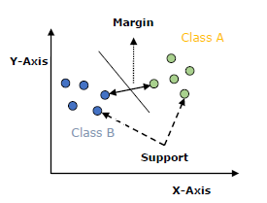
Support Vector Machine - SVM.
Support vector machines (SVMs) are powerful yet flexible supervised machine learning algorithms which are used both for classification and regression.
The goal of SVM is to divide the datasets into classes to find a maximum marginal hyperplane (MMH).
Support Vectors − Datapoints that are closest to the hyperplane is called support vectors. Separating line will be defined with the help of these data points.
Hyperplane − As we can see in the above diagram, it is a decision plane or space which is divided between a set of objects having different classes.
Margin − It may be defined as the gap between two lines on the closet data points of different classes. It can be calculated as the perpendicular distance from the line to the support vectors. Large margin is considered as a good margin and small margin is considered as a bad margin.

Slide 4
Block Diagram – Workflow of Attendance System.
Dataset Creation
With CSV name & Rollno
Pre-processing-
Face Detection
Pre-Processing – 128-D embedding for ML
Training – ML - SVM
Load Model, LE & CSV
Pre-process frame from Camera
Classification

Slide 5
Installing Libraries
sklearn: pip install sklearn

Slide 6

! PRACTICAL SESSION !
ATTENDANCE SYSTEM

Slide 7
DATASET CREATION

Slide 8
PRE-PROCESSING WITH EMBEDDINGS

Slide 9
TRAINING WITH ML

Slide 10
ATTENDANCE SYSTEM

Slide 11
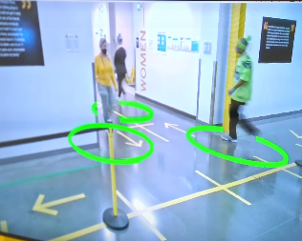
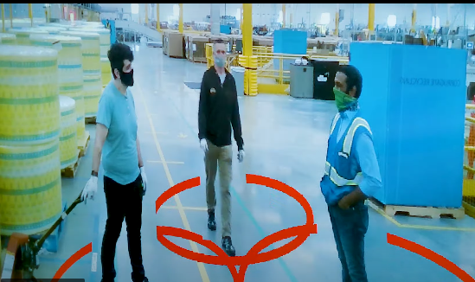
AI News – Day 17. 2020
Amazon has used its AI expertise to create what it calls the Distance Assistant. Using a time-of-flight sensor, often found in modern smartphones, the AI measures the distance between employees.

Slide 12
Thanks!
Tomorrow session
Do you have any questions?
sanjay@pantechmail.com
www.pantechsolutions.net
Vehicle Detection

Slide 13
Day-17 Agenda.
01.
02.
03.
Attendance System
ML - SVM
Workflow
04.
05.
Q & A
Deploying Face recognition system using ML & DL
Face Recognition with Attendance system
Support Vector Machine
Workflow of Attendance system
Converting Text from Image

